Slide 1

Hot Topics in Oncology:
Biosimilar Monoclonal Antibodies
Pharmacovigilance
University Medical Center
Department of Pharmacy, Prof. Dr. Irene Krämer
www.prIMEoncology.org

Slide 2
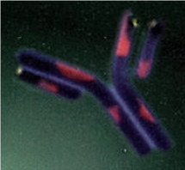
Pharmacovigilance/Risk Management Plan
“…is to be presented in accordance with current
EU legislation and pharmacovigilance guidelines”
In order to study safety in the post-authorisation setting
Safety in extrapolated indications, long-term safety data
Additional immunogenicity data, if considered
Proactive pharmacovigilance activities, e.g. registries
Adverse reaction report with name and batch number
Switching and interchanging
EMA Guideline on Similar Biological Medicinal Products containing monoclonal Antibodies CHMP/BMWP/403543 2010
Notes:
The key component to monitor product safety is knowing what product is associated with a given adverse event (AE).
This supports arguments for assigning different INNs to biosimilar products and not allowing automatic substitution
Until the naming system for biosimilars is improved, use of proprietary (brand) name is recommended in addition to INN.
Adverse Drug Reaction (ADR) reports should include INN, brand name, manufacturer’s name, batch or lot number and country of origin.

Slide 3
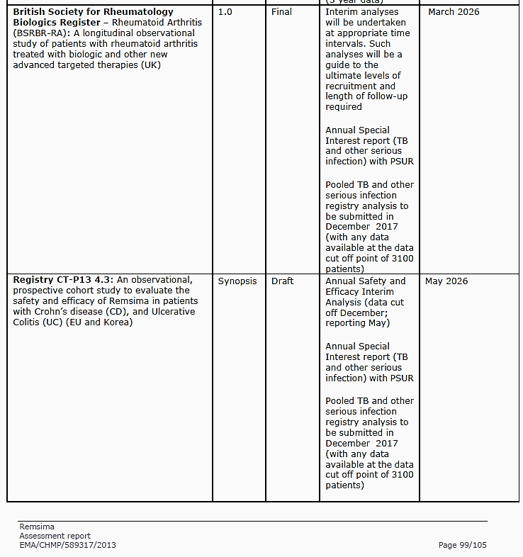
Case study: Remsima Pharmacovigilance Plans (excerpt)

Slide 4
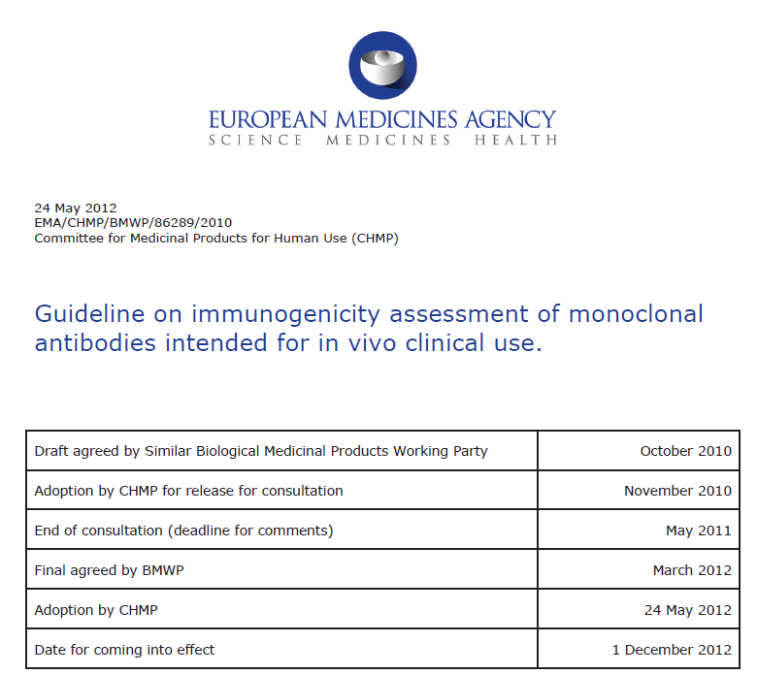
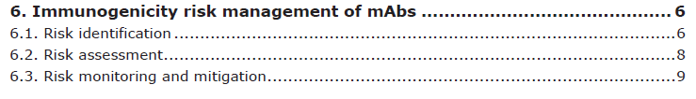
Revision under consultation
Comparative immunogenicity studies
Post licensing immunological studies
Notes:
The key component to monitor product safety is knowing what product is associated with a given adverse event (AE).
This supports arguments for assigning different INNs to biosimilar products and not allowing automatic substitution
Until the naming system for biosimilars is improved, use of proprietary (brand) name is recommended in addition to INN.
Adverse Drug Reaction (ADR) reports should include INN, brand name, manufacturer’s name, batch or lot number and country of origin.

Slide 5
Case study: Remsima CT-P13
Remsima Assessment report EMA/CHMP/589317/2013
Uncertainty in the knowledge about beneficial effects
There is a slightly higher level of aggregates in the CT-P13 product than in Remicade, which could potentially increase immunogenicity. However, the risk is considered to be negligible given the very low level and is not reflected in the clinical data.
Risks
There were no marked differences in the immunogenicity
profile of CT-P13 and Remicade up to 54 weeks and the
impact of antibodies on efficacy and safety was comparable
Notes:
The key component to monitor product safety is knowing what product is associated with a given adverse event (AE).
This supports arguments for assigning different INNs to biosimilar products and not allowing automatic substitution
Until the naming system for biosimilars is improved, use of proprietary (brand) name is recommended in addition to INN.
Adverse Drug Reaction (ADR) reports should include INN, brand name, manufacturer’s name, batch or lot number and country of origin.

Slide 6
Traceability and Naming
For accurate pharmacovigilance, both brand name and INN should be recorded when prescribing¹
Physician would be well advised to always document exactly which biological is used for an individual patient. In the ADR report ….INN, brand name, manufacturer, lot number, country of origin to ensure a proper root cause analysis²
For suspected adverse reactions ….. the definite identification of the concerned product with regard to its manufacturing is of particular importance. Therefore, all appropriate measures should be taken to identify clearly any biological medicinal product …..
with due regard to the name … and the batch number³
Declerck P. Drug Safety 2007;30:1087-92; 2. Ehmann, F., Schneider K. HPE 2011;56:32-35,
3. EMA Guideline on Similar Biological Medicinal Products containing monoclonal Antibodies CHMP 403543 2012
Notes:
The key component to monitor product safety is knowing what product is associated with a given adverse event (AE).
This supports arguments for assigning different INNs to biosimilar products and not allowing automatic substitution
Until the naming system for biosimilars is improved, use of proprietary (brand) name is recommended in addition to INN.
Adverse Drug Reaction (ADR) reports should include INN, brand name, manufacturer’s name, batch or lot number and country of origin.

Slide 7
How similar is similar ?
Similarity
  Products of different manufacturers
  Similar to the reference product in quality, efficacy (therapeutic equivalence), tolerability (EMA)
  Not meaningfully different from the reference product in terms of safety, purity and tolerability (FDA)
Comparability (ICH Q5E)
  Product of the same manufacturer
  Exercise to ensure the quality, safety and efficacy of a biological product subject to changes in the manufacturing process (pre- / post-change)

Slide 8
Interchangeability of Biosimilars
Interchangeability: Exchange of one medicine for another expected to achieve the same clinical effect in a given clinical setting
Since biosimilar and biological reference medicines are similar but not identical, the decision to treat a patient
with a reference or a biosimilar medicine should be
taken following the opinion of a qualified healthcare professional.¹
It is not possible we would guarantee a biosimilar is interchangeable (with its originator) and substitution is a national competency and needs to be discussed at the national level²
1. London, 19 April 2007 Doc. Ref. EMEA/74562/2006; 2. EMEA Executive Director Thomas Lönngren 2006
Adapted from: ²²Krämer et al. EJHP Practice 2008:14;73–76
Notes:
Evaluation of a biosimilar: Storage and handling
Storage and handling can affect the quality and integrity of the product
Therefore, correct storage and handling by the manufacturer and within the hospital is important
In the evaluation of a biosimilar, several aspects related to storage and handling should be considered:
As biologics are sensitive to degradation by changing environmental conditions, how does the supplier ensure product integrity is maintained from manufacture until it reaches its destination?
What documentation is available to confirm maintenance of required handling and storage conditions during shipping?
Are there any differences between the originator biologic and biosimilar with respect to storage or handling? (differences in storage and/or handling requirements are best avoided as they could potentially lead to errors)
What is the shelf-life of the biosimilar and is it different to the originator biologic?
Does the manufacturer provide information about the appropriate actions to be taken if maintenance of the recommended storage conditions has been temporarily disrupted?
Source: ²²Krämer et al. EJHP Practice 2008:14;73–76

Slide 9
Substitution of Biosimilars
Substitution
Refers to a national policy which permits the switch from one to another medicine that has been demonstrated to have the same quality, safety and efficacy
Automatic substitution typically occurs at retail or hospital pharmacies without consulting the prescriber
Depending on the handling of biosimilars and reference medicinal products in clinical practice at national level, ‘switching’ of medicines that contain a given mAb might occur. Thus applicants are recommended to follow further development in the field and consider these aspects as part of the risk management plan.
Guideline on Similar Biological Medicinal Products containing monoclonal Antibodies CHMP/BMWP/403543 2010

Slide 10

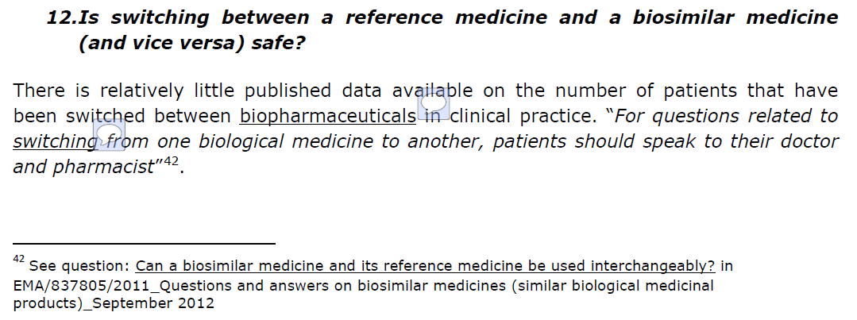

Slide 11
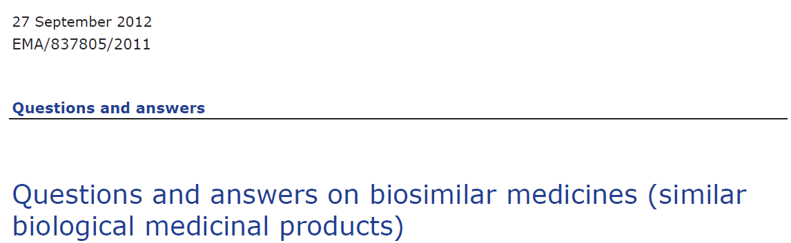
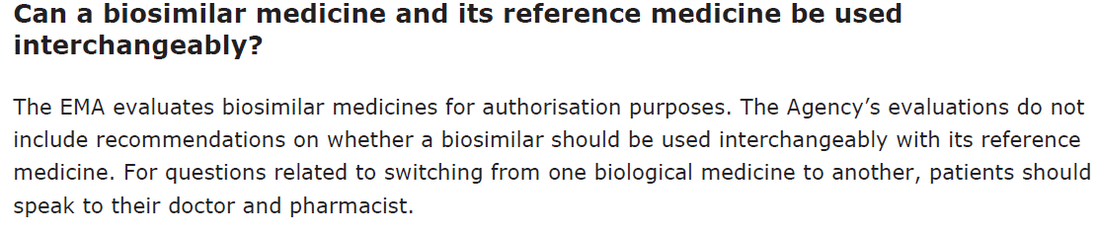

Slide 12
Substitution of Biosimilars in Germany
Automatic substitution of biosimilars not allowed
Automatic substitution of bioidenticals allowed
Example
Remicade®
infliximab, J&J
Automatic
Substitution
Inflectra®
infliximab, Hospira
Remsima®
infliximab, Celltrion

Slide 13
Risk management of Biosimilars in hospital practice
Substitution/switching should be combined with
Close monitoring of the patients
Ensured traceability
Decision making by a qualified healthcare professional

Slide 14
Risk management of Biosimilars in hospital practice
Use in extrapolated indications especially challenging
with regard to mAbs
Different post marketing commitments for different indications
Different patient groups (treatment naïve, multiple switching)
Information of the P&T committee, physicians about RMPs by hospital pharmacists
Consensus decision with responsible physicians
Additional workload, additional awareness

